Slide 1

LifeScore + AI Pitch
Team Trellis | EA Hackathon
Trellis combines the market wisdom of Advisors & the power of Machine Learning

Slide 2
What is Trellis?
Trellis is a Machine Learning system for Advisors and Underwriters
Trellis Mashup is a web crawler that searches public sources for policyowner metadata
Trellis AI is a machine learning model trained by public attributes selected by Advisors
Underlying Assumption
Financial Advisors can train insurance AI better than data scientists
Value Proposition
Highly competitive pricing for insurance offerings
Reduced underwriting risk to MassMutual

Slide 3
Trellis Stack

Slide 4
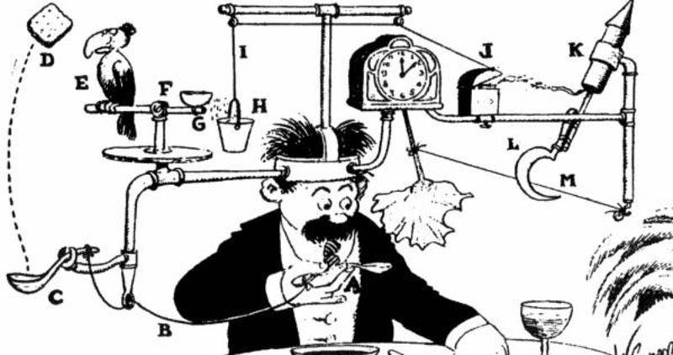
Demo

Slide 5

Trellis Seed
Trellis needs a Seed which can be any unique individual identifier
TrellisRobot
CrawlerAPI
NodeJS
Docker
Kubernetes

Slide 6
Trellis Mashup
Mashup of public metadata sources ranked by Advisor popularity

Slide 7
Trellis AI Training
Advisor explores public sources and selects metadata to try

Slide 8
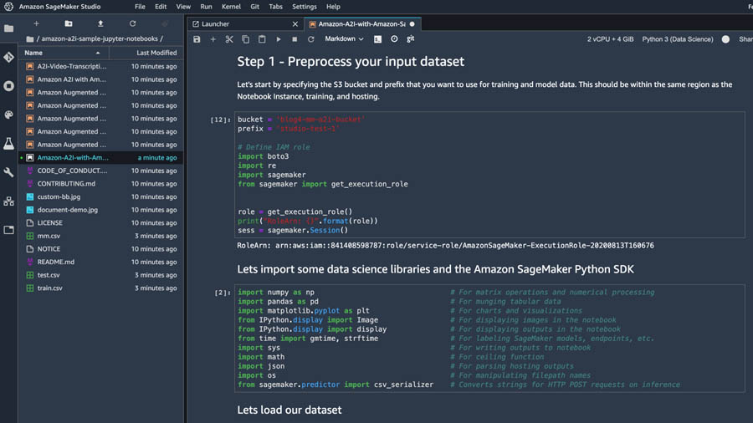
Trellis AI Execution
Trellis adds ‘twitter followers’ attribute and executes against client data set

Slide 9

Trellis AI Steps
1. Statistical Significance
2. Train SageMaker Model
All LifeScores
1k+ Followers LifeScores
10,181 dataset
f(x) = LifeScore
89
train
Δ7
82
3. Execute Model for Alice
4. Calculate Enhanced LifeScore
x = 1,422
Key E = Enhanced LifeScore a = Alice’s Original LifeScore (81) s = SageMaker LifeScore Δd = Delta from Step 1
f(x) = s = 91
s, s < Δd
E =
= 88
a + Δd, s > Δd

Slide 10
Results
Advisor sees results in terms of Alice & MM Products

Slide 11
Q & A
Questions?
Comments?

